Slide 1
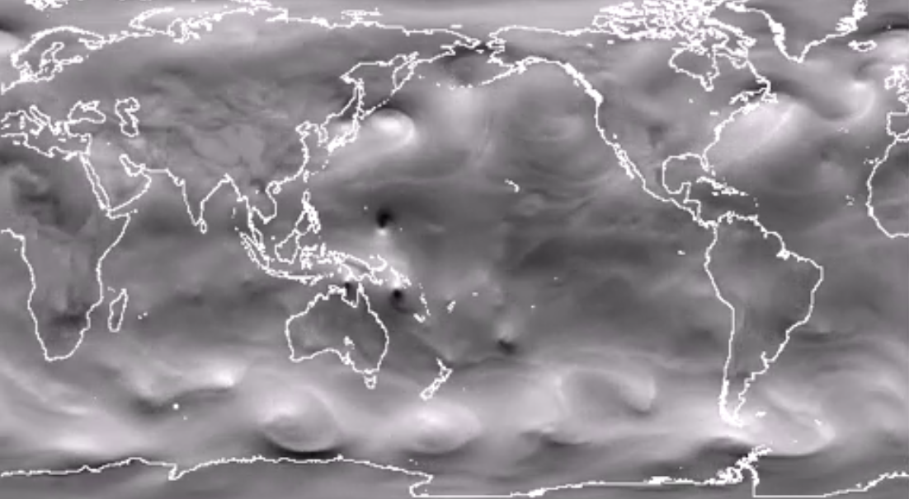
Are climate models any good or useful at all?
Data or model?
https://www.gfdl.noaa.gov/visualizations-hurricanes/

Slide 2
Common misconceptions about modeling
The goal of modeling is to reproduce data
If a model doesn’t fit the data, the model is useless (…and modeler also)
Since modelers don’t measure anything, they don’t know anything about data or care about them
Measurement(s) of “X” can be used to better constrain climate models
Process “W” is not explicitly implemented in the model, hence the model cannot model the effect of “Z” on climate as “W” has or may have an (unquantified) effect of the “Z” and may effect CO₂ or T, etc. … therefore climate models are useless

Slide 3
Some better propositions
All models are “wrong” and “incomplete”
(modeling with the sole goal of fitting data can be futile)
(state-or-the-art models have many free parameters, uniqueness of the fit/solution is not always guaranteed – fit for wrong reason possible)
Models have the merit of being internally consistent and possess fundamental conservation properties (mass, momentum, energy) that arm-wavy arguments do not have
(It’s much easier to explain data with arm-wavy arguments)
(…but models can provide means to test hypotheses)
Models can be wrong in many different ways
(figuring out why they are wrong is where learning occurs)
(data come in to inform parameterizations and testing simulations)
The skill of a “modeler/analyst” is less in knowing how to model (i.e math, computer science) and more in how to make useful sense of incomplete/uncertain results and design meaningful experiments
(experimental design is key)

Slide 4
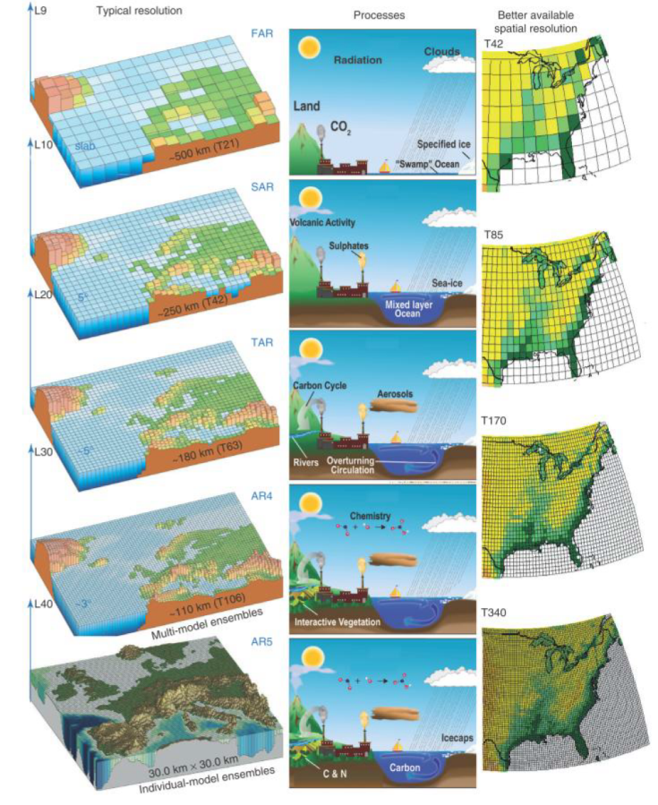
Model resolution
Increasing spatial resolution
…also means increasing temporal resolution to maintain numerical stability
(i.e. decrease time step)
Huge cost of resolution:
2x increase in spatial resolution in all dimensions means
2³=8x more computations
2³=8x more memory
2³=8x more time
With decreased time-step
>16x slower and more demanding
Notes:
Computation of the solution is carried out on a three-dimensional spatial grid. Increasing model resolution enables better resolution of processes, but this comes at considerable computational cost. For example, increasing horizontal resolution by a factor of 2 (say from 100 to 50 km²) generally requires a factor of 2 decrease in time step for numerical stability. Thus, the overall computational cost is a factor of 8. Furthermore, to avoid distortion of the results, the horizontal resolution cannot be increased without concomitant increases in vertical resolution. Increasing complexity independently adds to the computational cost of a model, so a balance must be sought between resolution and complexity. In practice, the ensemble of these considerations has led to an increase in atmospheric grid resolution from ~500 km to ~100 km in state-of-the-science climate models since the 1970s.
There is considerable evidence that refining the horizontal spatial resolution of climate models improves the fidelity of their simulations. At the most fundamental level, increasing resolution should improve the accuracy of the approximate numerical solutions of the governing equations that are at the heart of climate simulation. However, because the climate system is complex and nonlinear, numerical accuracy in solving the dynamical equations is a prerequisite to climate model fidelity, but is not the only consideration.
One of the more obvious impacts of improving climate model resolution is the representation of geographic features. Resolving continental topography, particularly mountain ranges and islands, can significantly improve the representation of atmospheric circulation. Examples include the South Asian monsoon region and the vicinities of the Rockies, Andes, Alps, and Caucasus, where the mountains alter the large-scale flow and give rise to small-scale eddies and instabilities. Resolving topography can also improve simulations of land-surface processes such as snowpack and runoff that rely strongly on orographically modulated precipitation and temperature (e.g., Leung and Qian, 2003) and may also have upscaled or downstream effects on atmospheric circulation (e.g., Gent et al., 2010) and clouds (e.g., Richter and Mechoso, 2006). Similarly, weather and climate variability associated with landscape heterogeneity, as well as coastal winds influenced by local topography and coastlines, are better represented in models with refined spatial resolution, which can also lead to improved simulation of tropical variability through improved coastal forcing (Navarra et al., 2008).
Finally, there is evidence of feedbacks that are strongly dependent on model resolution and that therefore influence a model’s response to perturbations, for example:
• atmospheric blocking, which is dependent on the feedbacks between the large-scale atmospheric circulation and mesoscale eddies (Jung et al., 2011);
• feedbacks between western boundary currents with sharp temperature gradients in the ocean and the overlying atmospheric circulation (Bryan et al., 2010; Minobe et al., 2008);
• feedbacks between tropical instability waves in the ocean and wind speed in atmospheric eddies (Chelton and Xie, 2010);
• air-sea interactions in presence of a sea-ice cover, which depend on the accuracy of detailed representation of sea-ice states, including ice edge position, thickness distribution, and deformations; and
• ice sheet-ocean interactions, which require representation of local flow under and into the ice, including fjord circulation and exchanges.

Slide 5
Benefits of improving resolution?
Better numerical accuracy in solving dynamical equations
Smaller discretization steps
Better representation of topography/bathymetry (mountains, islands, seamounts…)
Grid-boxes have vertical walls (depends on coordinate system)
Explicit inclusion of subgrid-scale processes
Parameterizing vs. resolving (e.g. eddies, overflows, etc)
Property gradients can be larger
Affects pressure gradients (i.e. velocity of currents)
Model becomes more advective and less diffusive, maybe more turbulent
Exchange-processes that depend on gradient become stronger (strong exchange, although on shorter spatial scales, e.g. air-sea heat fluxes)
Better agreement with the way data are collected (i.e. what observations mean)
Averaging over space/time and variability
https://www.gfdl.noaa.gov/climate-modeling/

Slide 6
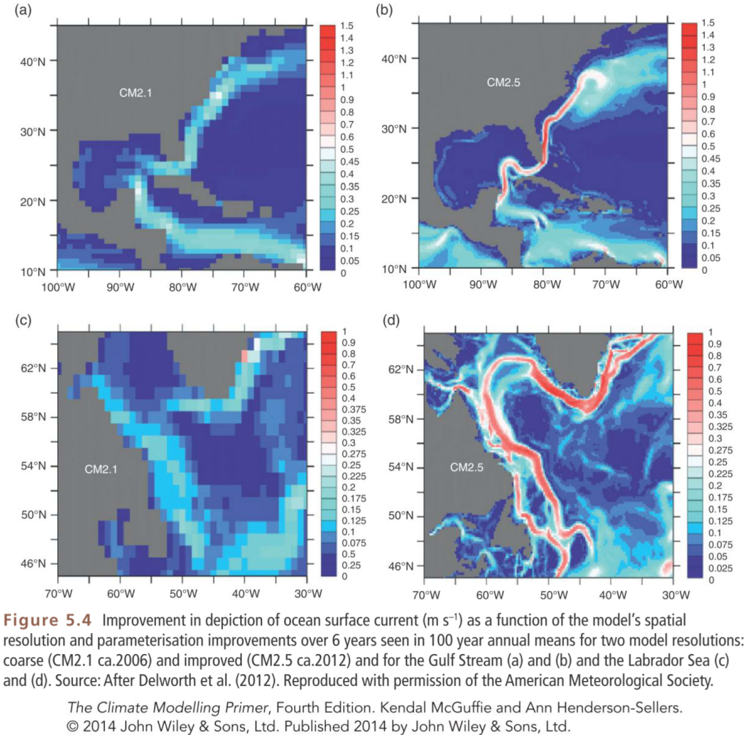
~100km cells
~10km cells
Gulf Stream
Labrador Sea

Slide 7
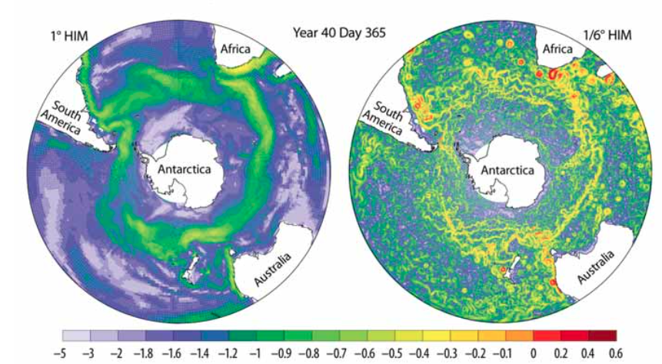
Ocean resolution: 2 cases resolving eddies (the ocean’ storms)
Figure 6.1. Surface-Current Speed in Two Simulations of the Southern Ocean in Low- and High-Resolution Ocean Models.
[From Fig. 6 in R. Hallberg and A. Gnanadesikam 2006:The role of eddies in determining the structure and response of the wind-driven Southern Hemisphere overturning: Results from the modeling eddies in the Southern Ocean (MESO) project. J. Physical Oceanography, 36, 2232–2252. Reproduced by permission of the American Meteorological Society (AMS).]
Notes:
Figure 6.1. Surface-Current Speed in Two Simulations of the Southern Ocean in Low- and High-Resolution Ocean Models.
[From Fig. 6 in R. Hallberg and A. Gnanadesikam 2006:The role of eddies in determining the structure and response of the wind-driven Southern Hemisphere overturning: Results from the modeling eddies in the Southern Ocean (MESO) project. J. Physical Oceanography, 36, 2232–2252. Reproduced by permission of the American Meteorological Society (AMS).]

Slide 8
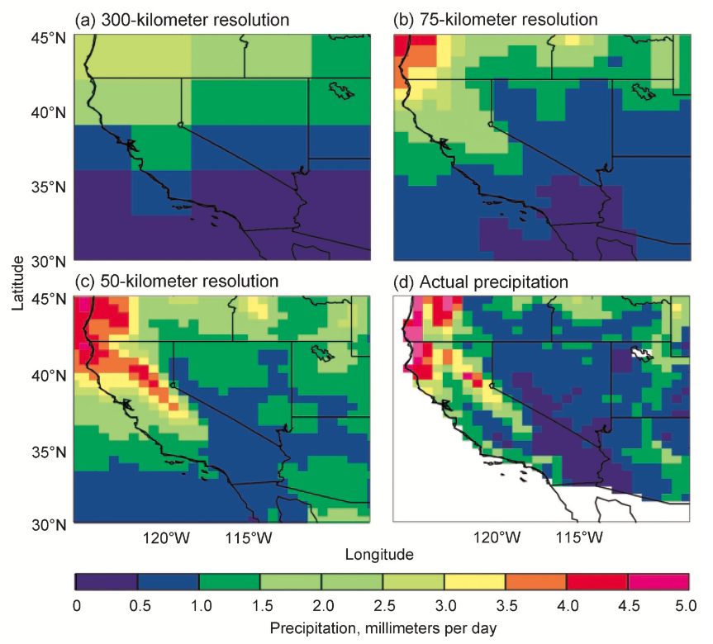
Atmospheric resolution: 3 cases What are implications for interpretation, decision/policy making?
California
California
California
California
Notes:
FIGURE1.4 Annual-meanprecipitationinthewesternUnitedStatessimulatedbyaclimatemodelwith three different resolutions (300, 75, and 50 km) compared with observational data (VEMAP) at 50-km reso- lution. The higher-resolution model (c) shows better agreement with observations (d). SOURCES: Walter, 2002, based on Figure 13 in Duffy et al., 2003.

Slide 9
Comparing models with data
What is a data point? Observation vs model result
Are model solutions at a point similar to a data point (i.e. observational sample)?
Spatially?
Temporally?
Using data well is not a trivial task. It requires understanding the model well and the data well
A trend towards “Observational System Simulation Experiments” (OSSE)
data assimilation (e.g. 4DVAR)

Slide 10
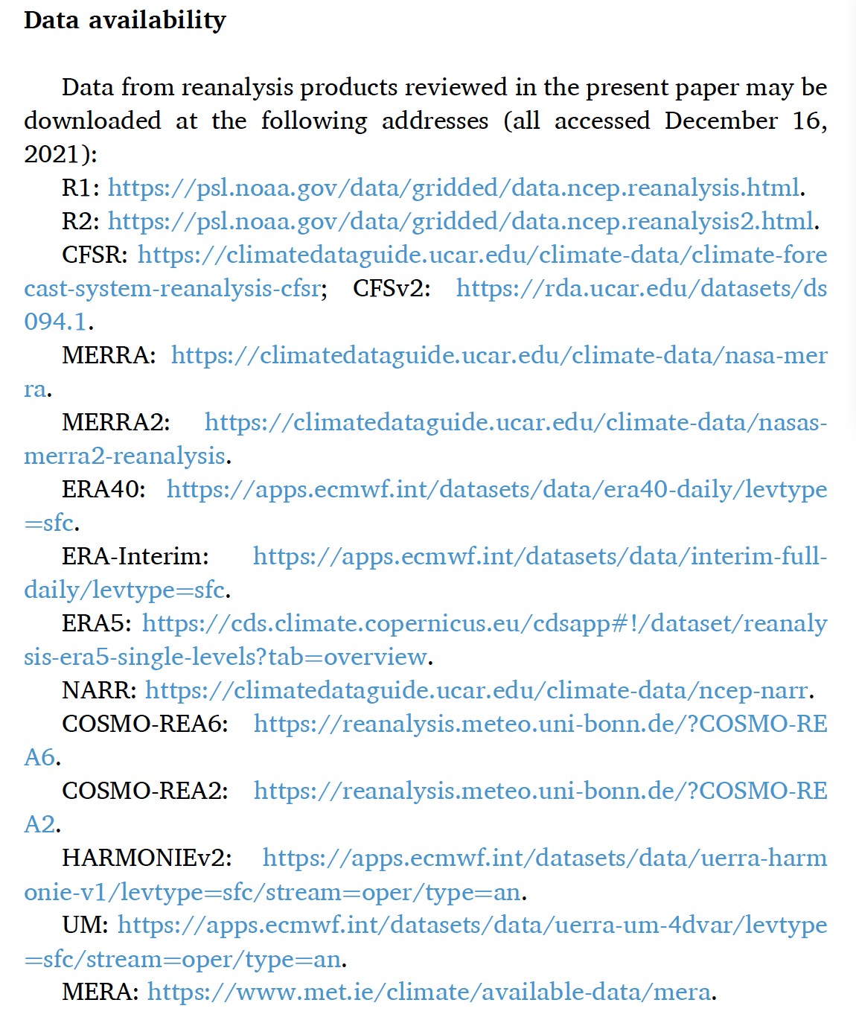
“Re-analysis products”
These are *NOT* observations
These are model output that were generated through some form of ‘data assimilation’
Our current ‘best guess’ of what global weather is like
Each product is generated at a given resolution (also suffers from discretization)
Can only assimilate data when data exist, implying products only exist for observational period
These are not weather forecasts (but of course, can be used as initial conditions for forecasts)
e.g. Gualtieri (2022) https://doi.org/10.1016/j.rser.2022.112741

Slide 11
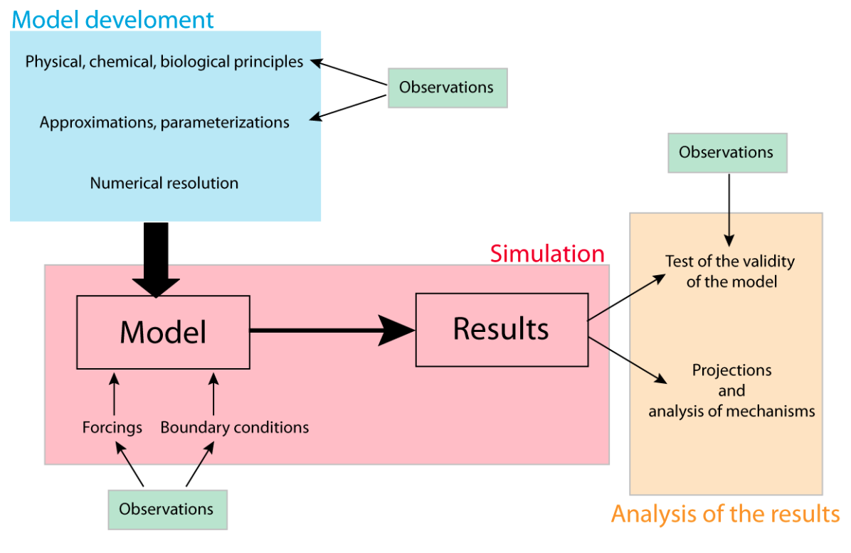
The role of observations in modeling
http://www.climate.be/textbook/pdf/Chapter_3.pdf

Slide 12
Models vs observations
There are data that are ’just’ observations
There are models that are ‘just’ models
There are models that are ‘assimilated with data’
Often called ‘Reanalysis Products’
(also used in weather forecasting, obviously)
These are models that are ‘fitted’ to data
Some model parameters are tuned to fit
Question is what to fit/how? (Data assimilation, 4DVAR)
Provide best gridded high-resolution spatio-temporal product available … but:
they are still model results
Fitting a bad/wrong model still is a bad results
they only exist for the period when data exist
so cannot be used for forecasting
But extremely useful to understand past/current climate patterns/variability

Slide 13
Are models ever “right”?
Since models are incomplete by construction, what does “right” even mean?
What do we do if one model can represent a variable better but another variable worst?
A model can reproduce the mean state well but not the variability. Is it a “good” model?
What if model solution shows spatial and temporal patterns well, but is consistently offset?
Embrace/accept that sometimes the best we can do is to provide a probabilistic answer to questions

Slide 14
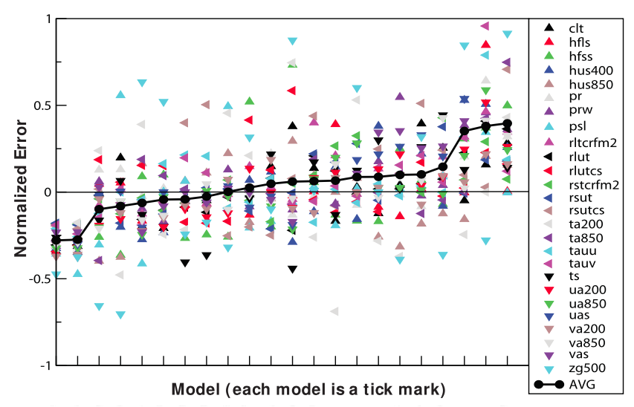
Which is the best “Metric” - a judgment call?
Model performance and deciding which is the best model?
More than mean
Different variables
Error relative to the multi-model mean
Less than mean
Different models
Notes:
Figure 2.5. Model Metrics for 23 Different Climate Fields.
Values less than 0 indicate an error less than the average CMIP3 model, while values greater than 0 are more than the average.The black triangles connected by the black line show a total score obtained by averaging all 23 fields. Each tick mark represents a different model. [Figure adapted from P.J. Gleckler, K.E. Taylor, and C. Doutriaux 2008: Performance metrics for climate models. J. Geophysical Research, 113, D06104, doi:10.1029/2007JD008972. Reproduced by permission of the American Geophysical Union (AGU).]

Slide 15
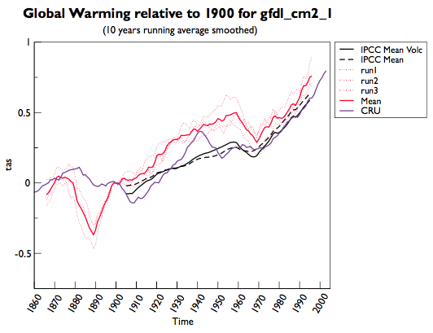
Internal variability vs “forced” response? Ensemble simulations
Run 1, 2, 3
are ‘ensemble’ runs
Averaged surface temperature anomaly
Today, 100s of ensemble runs can be generated
That’s a lot of data!
Notes:
Figure 5.3a. Simulation of 20th Century Globally Averaged Surface Temperature from GFDL CM2.1.
“CRU” is the value based on the Climate Research Unit gridded observational dataset,“IPCC Mean” is the average value of all CMIP3 models, and “IPCC Mean Volc” is the average of all CMIP3 models that included volcanic forcing. Individual realizations of the CMIP3 20th Century experiment are denoted by the dotted curves labeled “run(1–3),” and the ensemble mean is marked “Mean.”

Slide 16
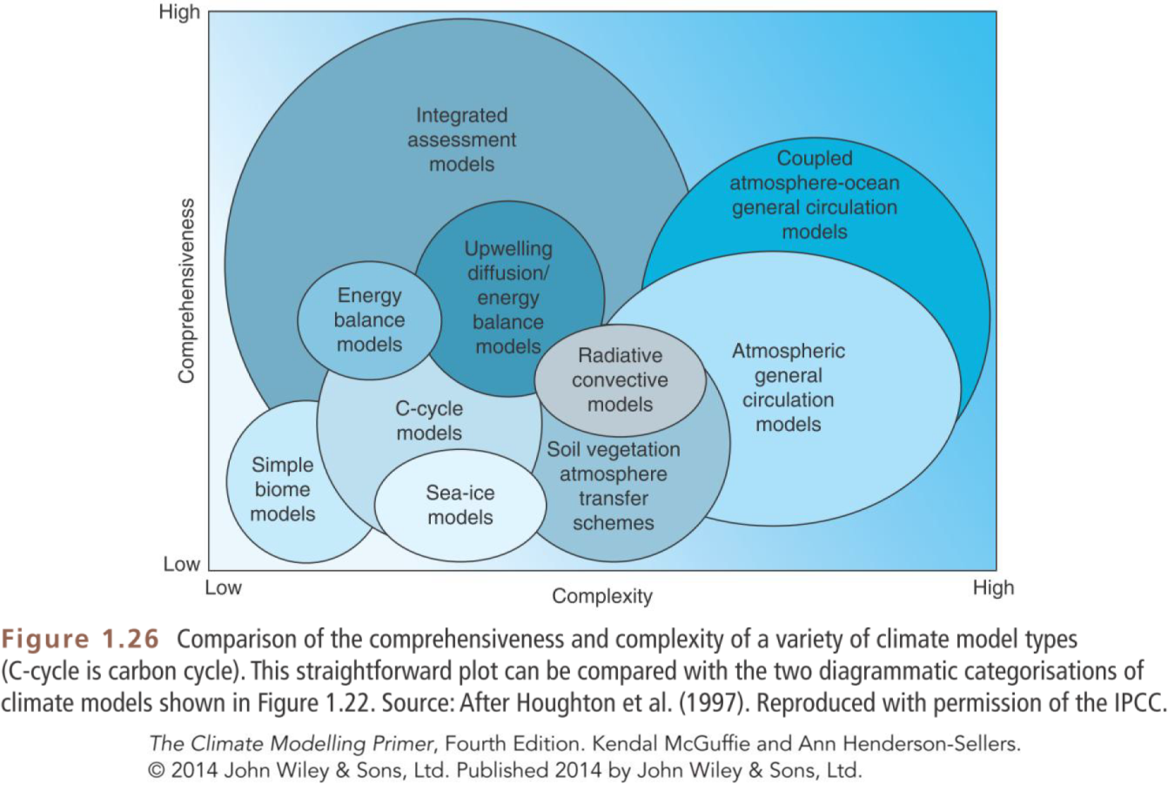
What model for what process, for what analysis?
Choosing the best model product for the job
If simple works, go simple! (less data to process) – not everything has to be coupled all the time!

Slide 17
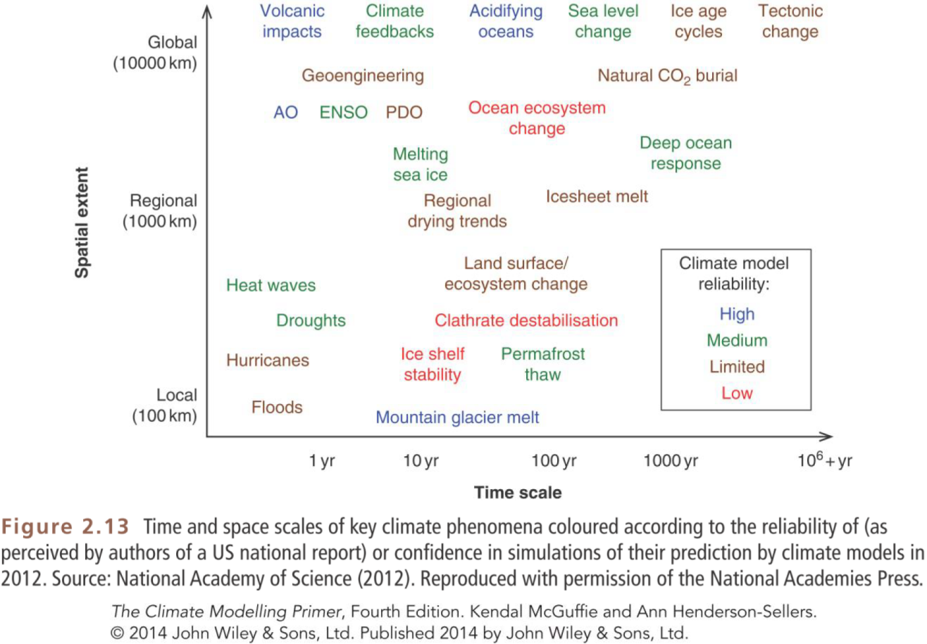
Can one model do it all?
Processes operate on various time/space scales
Notes:
The climate modeling primer

Slide 18
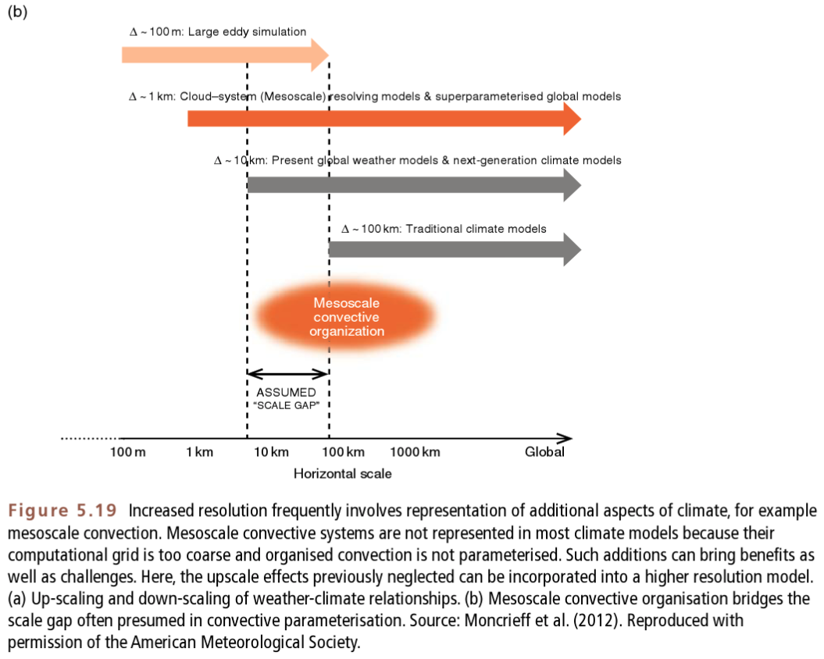
Higher resolution
(more data)
(local extremes)
(shorter simulation)
(no/few ensembles)
Lower resolution
(fewer data)
(longer simulation)
(many ensembles)

Slide 19
Take home messages
Models will always be imperfect (accept this!)
the challenge is to make them useful by keeping them as simple as possible in spite of their limitations
very difficult in practice, requires deep scientific knowledge
Understanding of the question and of the tools available
The skill of the analyst is to know how far to push the interpretation and to select the correct model/simulations for the right question (exploit experimental design)
Main sources of uncertainties to consider
Numerics and choice of equations/implementation
Resolution
Parameterizations
Boundary conditions and forcing and initial conditions
Internal dynamics
Influence of uncertainties on final conclusions of analysis must be considered

Slide 21
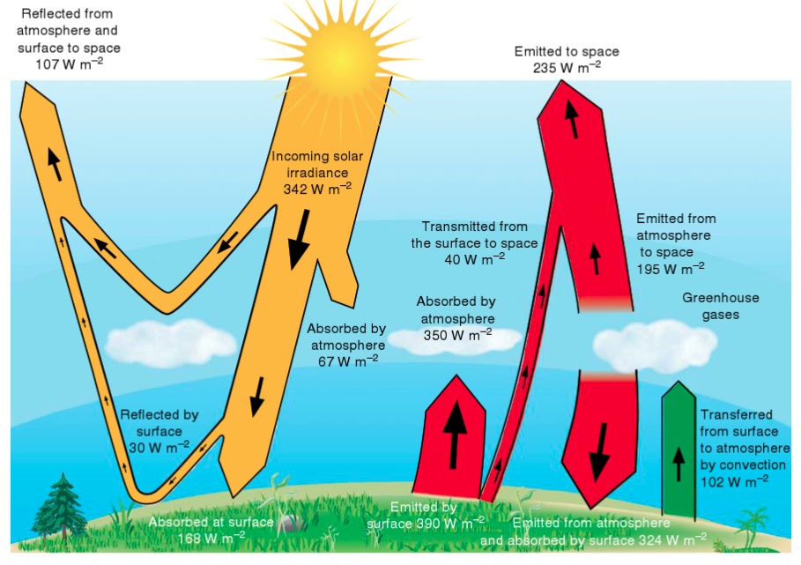
The atmosphere matters … a lot! Radiative-convective equilibrium

Slide 22
The hydrologic cycle challenge and Relative humidity (h)
It is the ratio of partial pressure of water vapor to the equilibrium partial pressure
“the salinity of the atmosphere”
Relative humidity decreases as T increases
Warm air can hold more water
More water = more clouds?
More low clouds = more albedo?
More high clouds = more greenhouse?
Question: If T increases and air can hold more water, what happens over deserts?

Slide 23
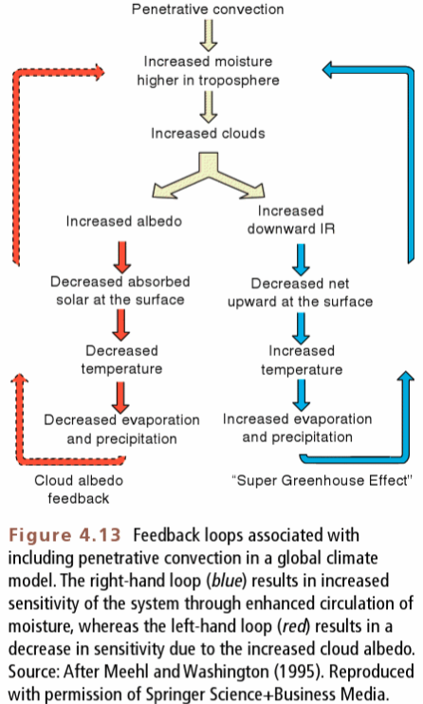
The “clouds” challenge
Clouds can both cool and warm the climate
The microphysics responsible for cloud formation is not well understood
The grid cells in models are much much bigger than time/space scales relevant for cloud physics
Magnitude/location of rain events is hard to predict well
That information is useful though!

